Slide 1
Predicting Customer Churn in Telecom Industry using Power BI and SQL
SHRI JEY SURYA K | MBE 11

Slide 2
Project objective
Objective: To predict customer churn and identify the factors that influence it.
By identifying key factors that contribute to customer churn, the project aims to provide actionable insights that telecom company can use to improve customer retention through interactive dashboards and data analysis.

Slide 3
Findings and Insights:
Majority of the churned customers are because of the competitors and the attitude of the support person.
Churn rate in San Diego city is very high.
Customers above the age of 60 has a churn rate of 35%, but the amount revenue generated from that category of people is fascinatingly high (i.e. $1.03M).
No Offers were provided for 890 of 1563 Churned Customers.
Monthly contracts are most likely to churn, with a churn rate of 20%.

Slide 4
Recommendations:
By providing multiple streaming options, high speed, unlimited download and other app subscriptions on yearly basis will be eye-catching offer for the churned customers which in turn will reduce the churn rate and will increase total yearly revenue.
Conducting a marketing campaign with special offers in San Diego city will help us to improve our retention rate.
Providing exclusive offers and discounts for customers who are above the age of 50

Slide 5
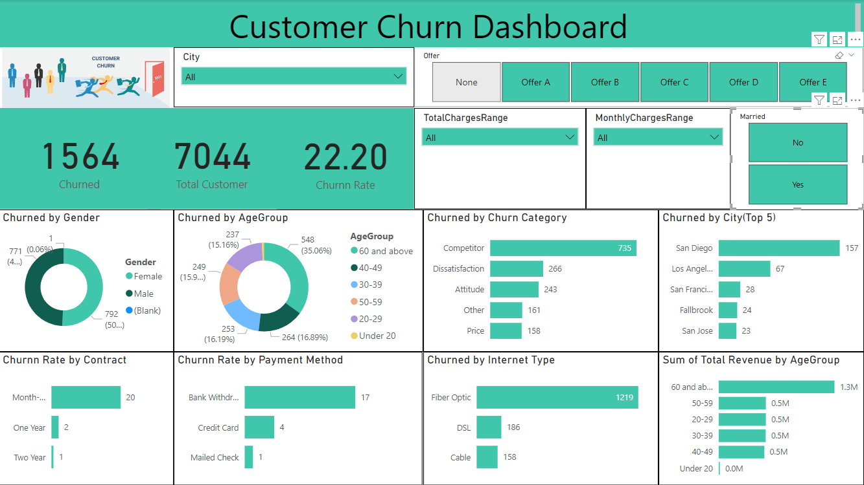

Slide 6
Thank You!

